Slide 1


INTERNATIONAL UNIVERSITY – VNU HCMC PROJECT (2024-2025 S1) IT069WE
OB
Object Oriented Programming
MegaMan
Student name and ID: - Nguyễn Trung Anh - ITITWE22122
- Hoàng Xuân Dũng - ITITWE22009
- Nguyễn Nhật Nam - ITITWE22149
- Nguyễn Quang Thái - ITCSIU22227
Group [01] – Test room: [LA1604]
Test date: [24 December 2024]

Slide 2
Introduction
General UML diagram
OVERVIEW:
Detailed Package and Class
Results and Demonstration
Conclusion

Slide 3
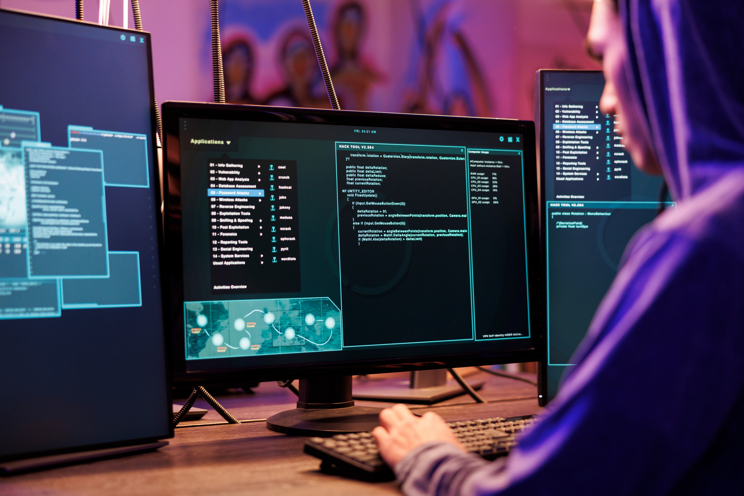
Folder structure overview
- Control: Handles game logic, state transitions, and input.
- GameObject: Defines all entities in the game (e.g., Megaman, enemies).
- GameEffect: Manages visual and audio effects.
- UserInterface: Contains UI elements like health bars and menus.

Slide 4
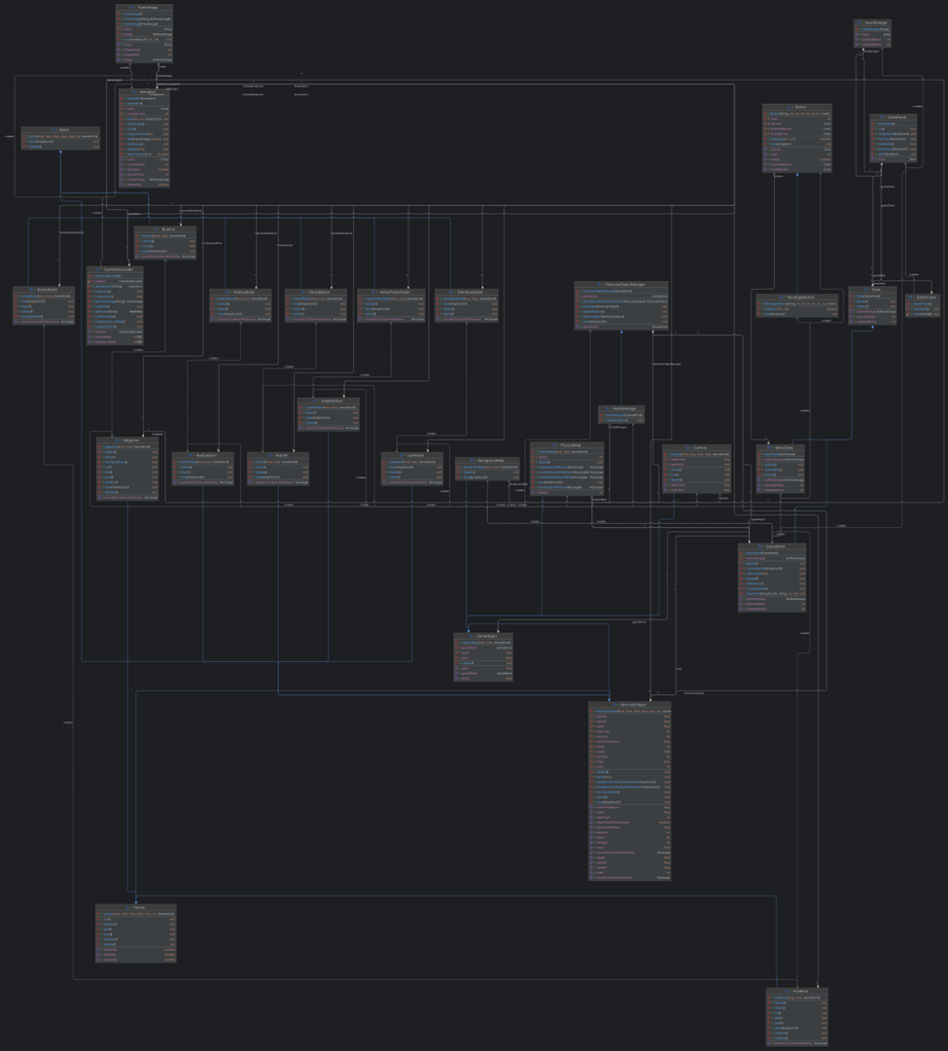
General UML diagram

Slide 5
Overview and UML
Control package The Control package manages game flow, input handling, and state transitions.
UML Diagram: Control Package Management
- handleInput()
- updateState()
- manageFlow()
Control
- label
- onClick()
- render()
- label
- onClick()
- render()
Button
RectangleButton

Slide 6
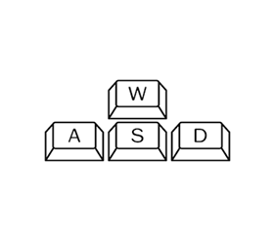
Button:
- Attributes: label
- Methods: onClick(), render()
RectangleButton:
- Inherits from Button
- Attributes: label
- Methods: onClick(), render()

Slide 7
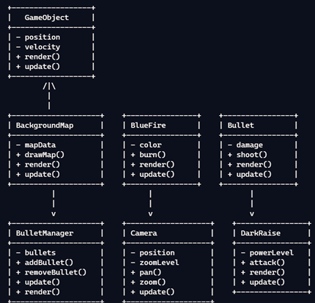
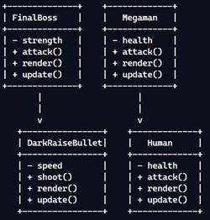
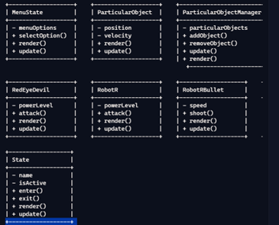
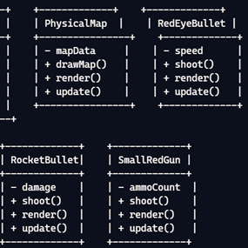
Overview and UML
- Overview: GameObject package contains the main entities in the game like characters and objects.

Slide 8
Overview and UML
Background Diagram:

Slide 9
Folder structure overview
-Control: Handles game logic, state transitions, and input.
-GameObject: Defines all entities in the game (e.g., Megaman, enemies).
-GameEffect: Manages visual and audio effects.
-UserInterface: Contains UI elements like health bars and menus.

Slide 10
Software Classification
System software
Utility software
Software can be classified into different categories based on its purpose and functionality.
Each software type has a role to play in computer systems.
Application software

Slide 11




System software is the software responsible for managing the hardware. It also provides a platform for running utility and application software.
Functions
System Software
Managing memory
User interface
Input and output
Managing applications
Examples
Windows
macOS
Linux
iOS

Slide 12



Utility Software
Utility software are programs designed to assist in system maintenance and management tasks.
This software is important in optimising system performance, ensuring security, and preventing data loss.
Examples
Anti-virus software
Backup utilities
Disk defragmenters

Slide 13



Application Software
Application software or ‘apps’ are programs designed to perform specific tasks for users.
Examples
Productivity
Entertainment
Communication
e.g. word processors
e.g. video games
e.g. web browsers

Slide 14
Drag and drop the software into the correct classification.
System Software
Android
Antivirus
Excel
Fortnite
Utility Software
iOS
Settings
Firewall
Linux
Application Software
Netflix
Backup
Windows
Spotify

Slide 15
Drag and drop the software into the correct classification.
System Software
Android
iOS
Linux
Windows
Utility Software
Antivirus
Settings
Firewall
Backup
Application Software
Excel
Fortnite
Netflix
Spotify

Slide 16
Choose a piece of software for each category. Research and fill in the comparative chart.
System
Utility
Application
Software Name
Type here
Type here
Type here
Publisher/Developer
Type here
Type here
Type here
Purpose/Function
Type here
Type here
Type here
Key Features
Type here
Type here
Type here
Compatibility
Type here
Type here
Type here
Cost
Type here
Type here
Type here

Slide 17
Choose a piece of software for each category. Research and fill in the comparative chart.
System
Utility
Application
Software Name
macOS
Norton
WhatsApp
Publisher/Developer
Apple
Symantec
Meta
Purpose/Function
Operating system
Security software
Communication
Key Features
Screensavers, widgets
Antivirus, antimalware
Text, image messaging
Compatibility
Mac devices
PC, Mac, tablet, phones
Phones, PC, Mac
Cost
Free with Mac
£19.99 per year
Free

